Slide 1
Logistics and Shipping Hub
Group Number-14
Shivdeep Bisurkar A20525712
Prajakta Kumbhar A20523710
Pavani Rangineni A20516359

Slide 2
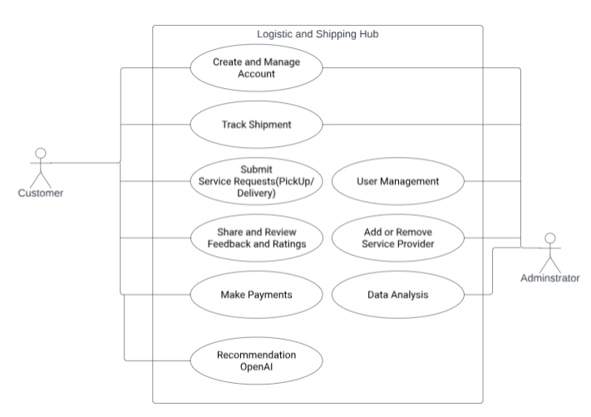
Architecture

Slide 3
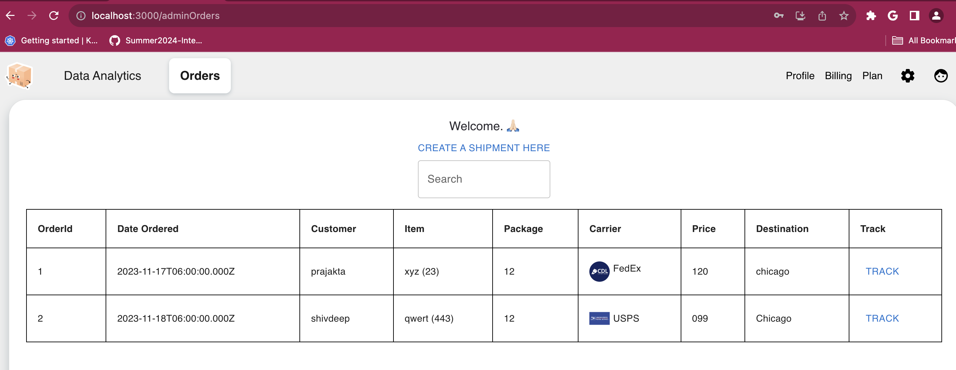
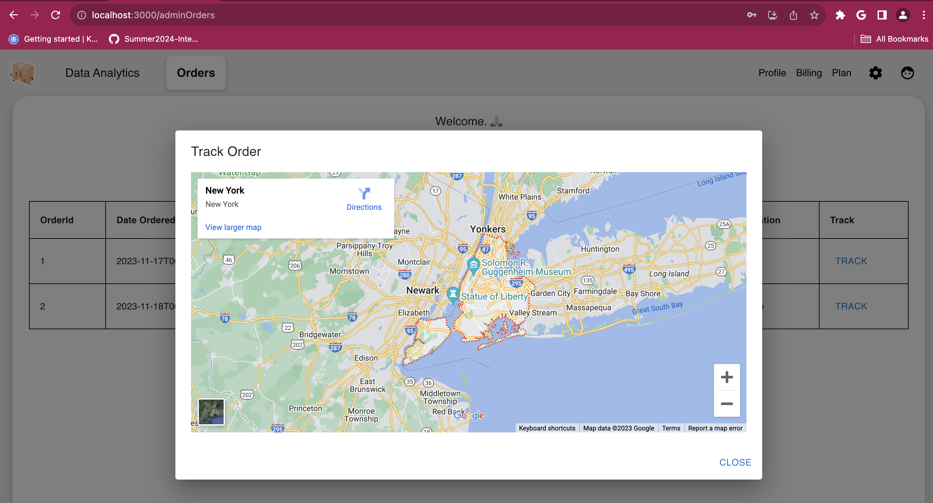
Screen shots

Slide 4
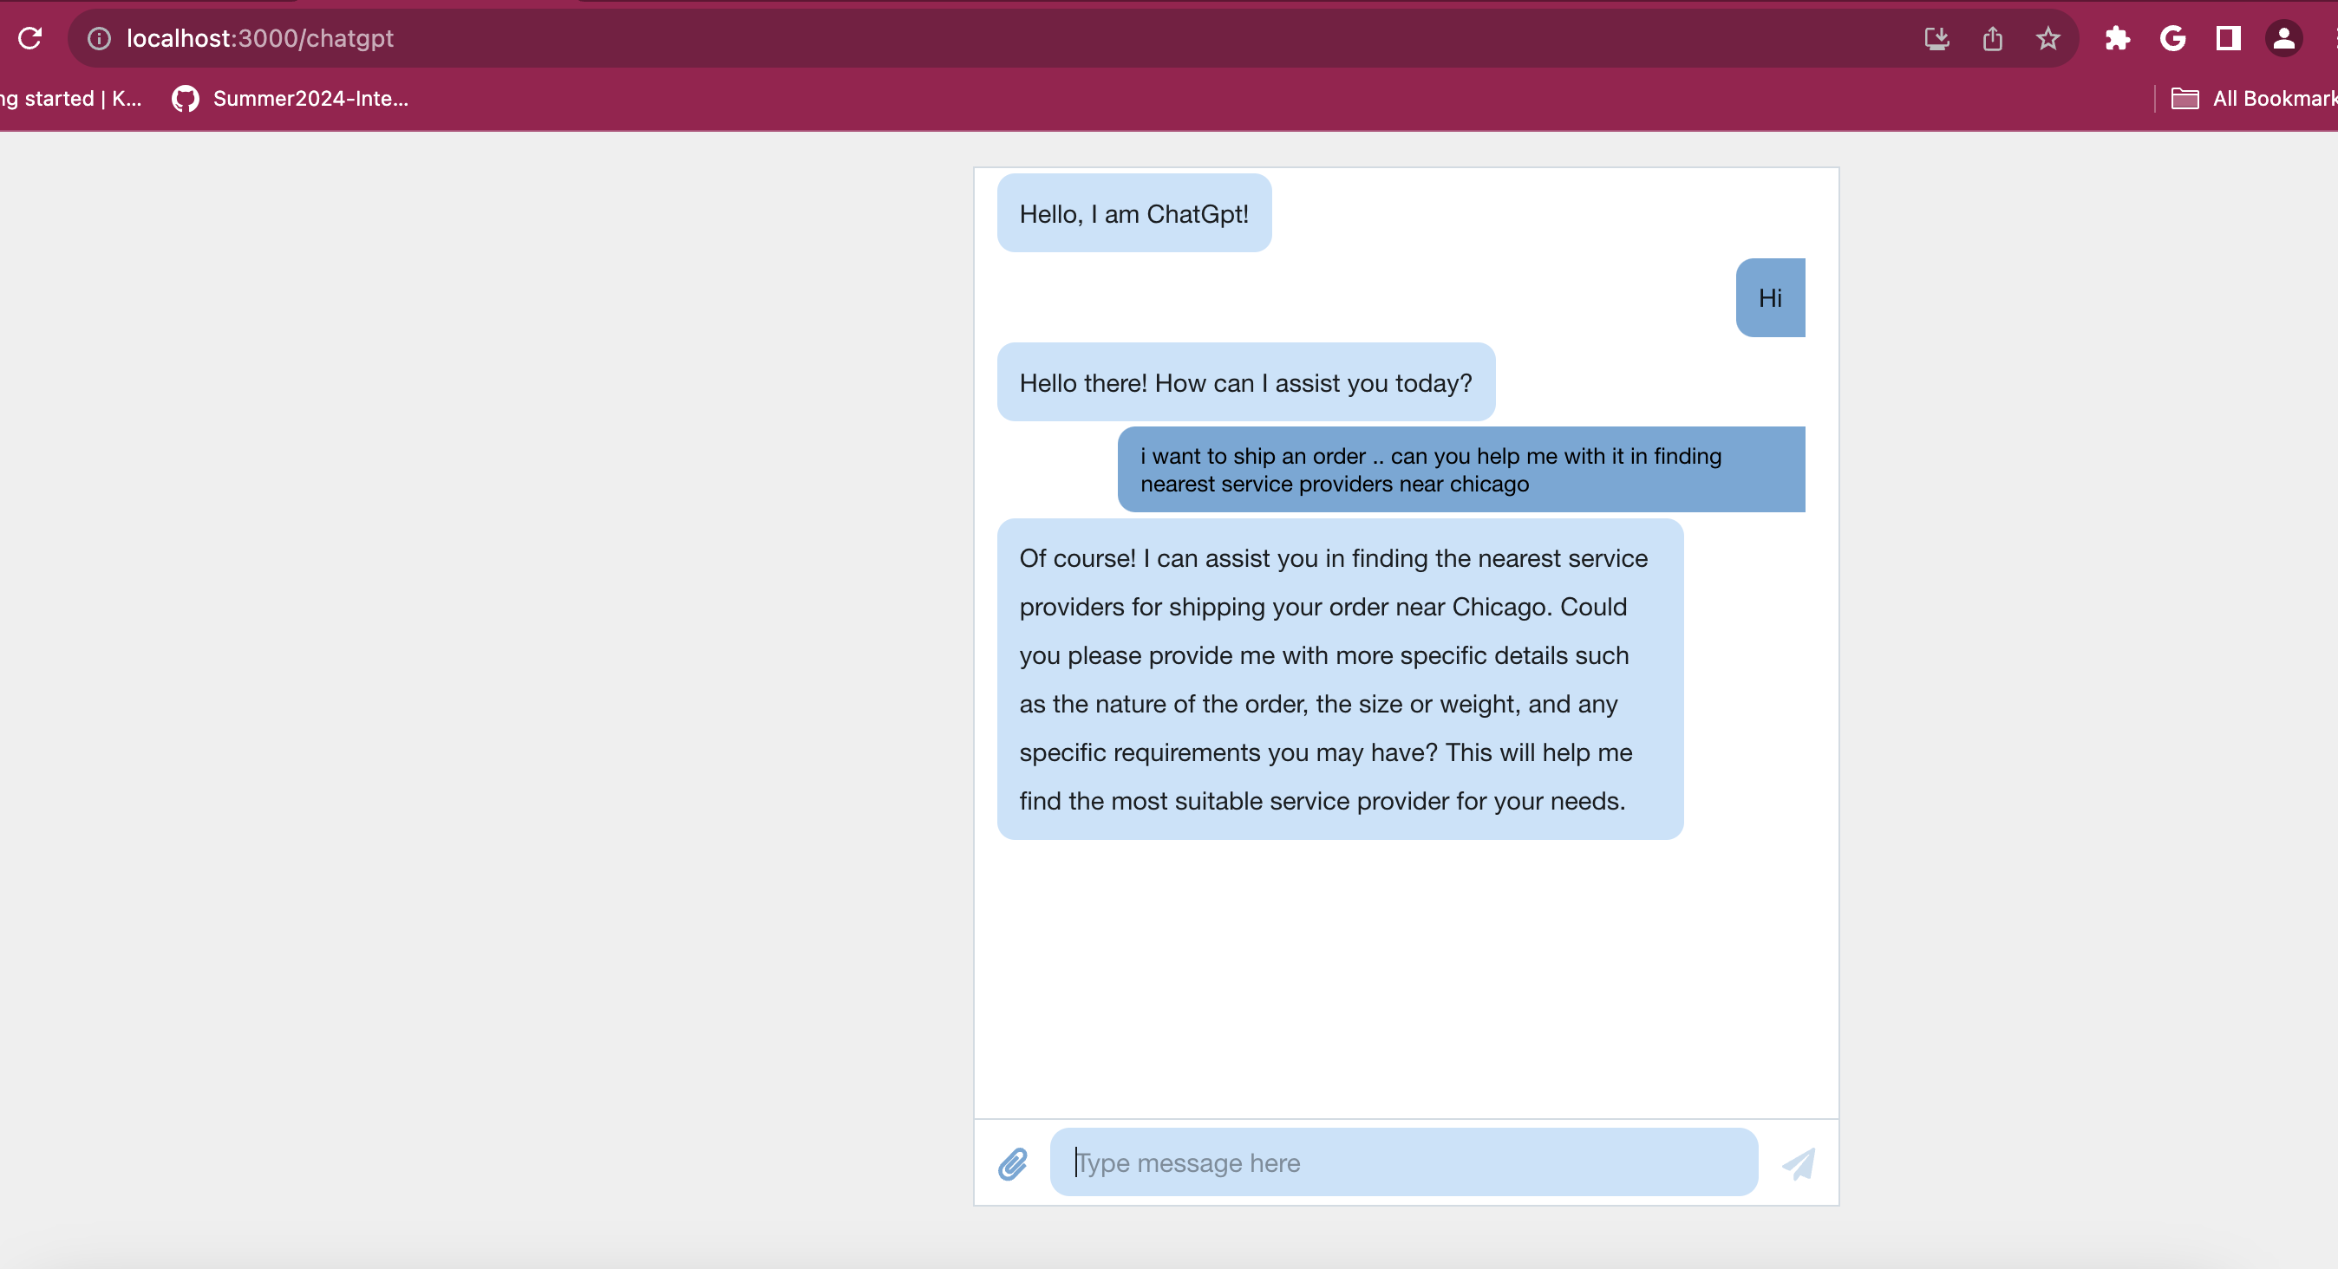

Slide 5
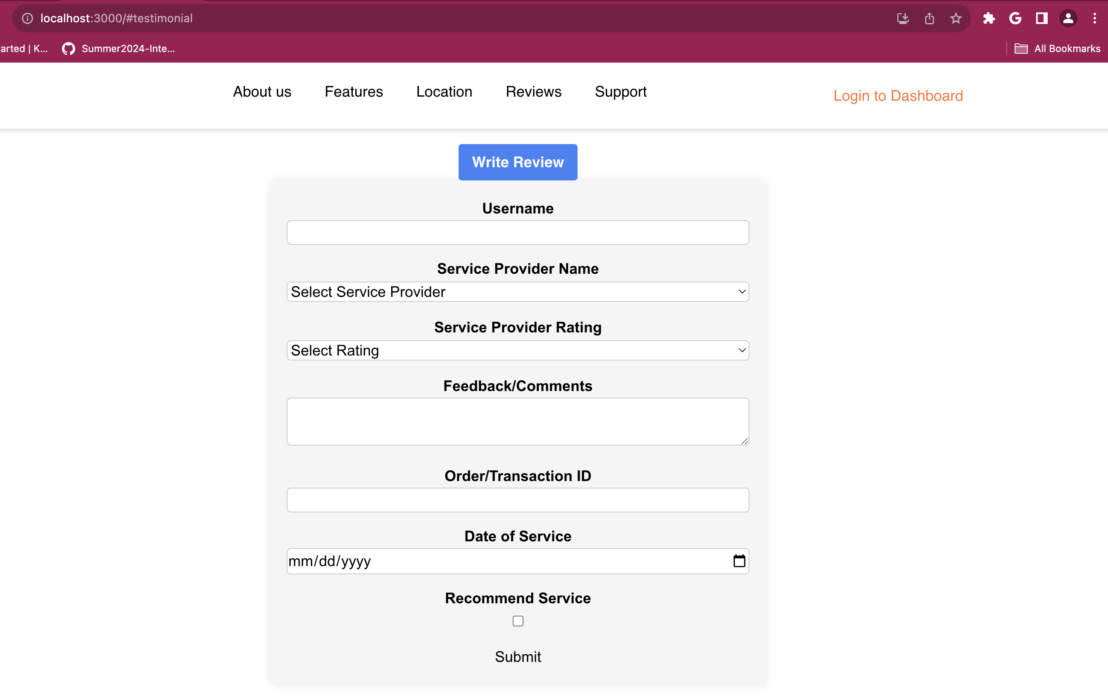
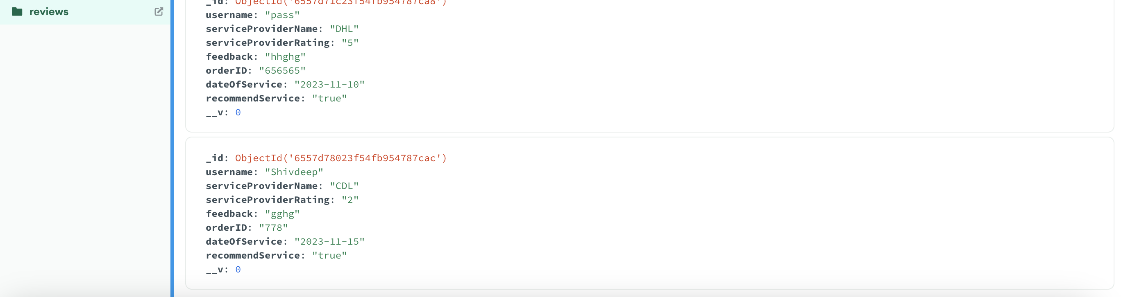

Slide 6
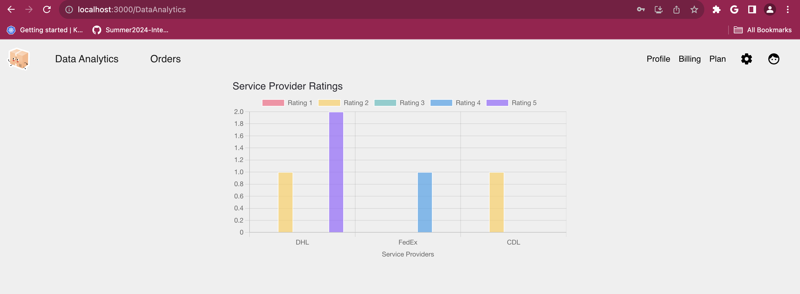

Slide 7

Thank you
Group No 14

